Slide 1

Presentation
Template
This is a presentation template that can help you as a manager to choose what relevant data to show your employees on a regular basis.

Slide 2

Weekli data
Weekli Value
58
Highest Value
”Quality of leadership”
89
Largest increase
”Stress”
72
Response rate
67%
Lowest Value
”Sleep Quality”
33
Largest decrease
”Life Balance”
39

Slide 3
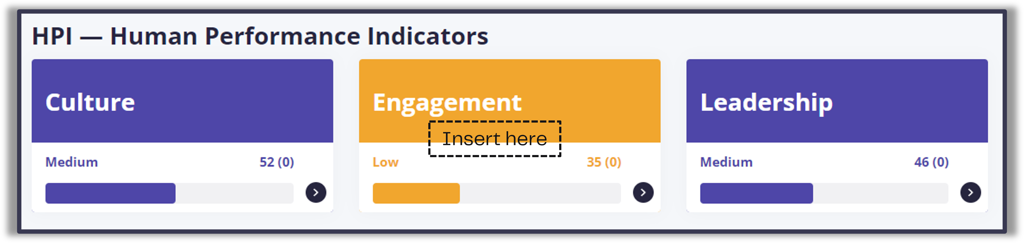
HPI:s

Slide 4
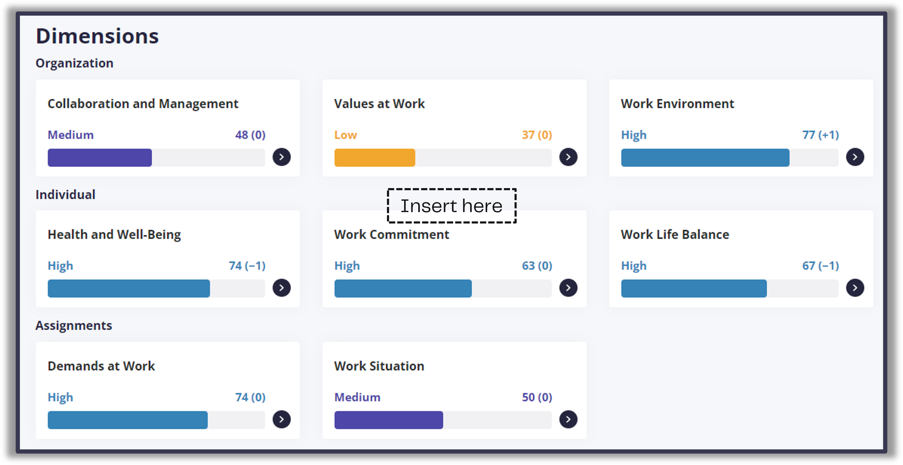
Dimensions
Insert here

Slide 5
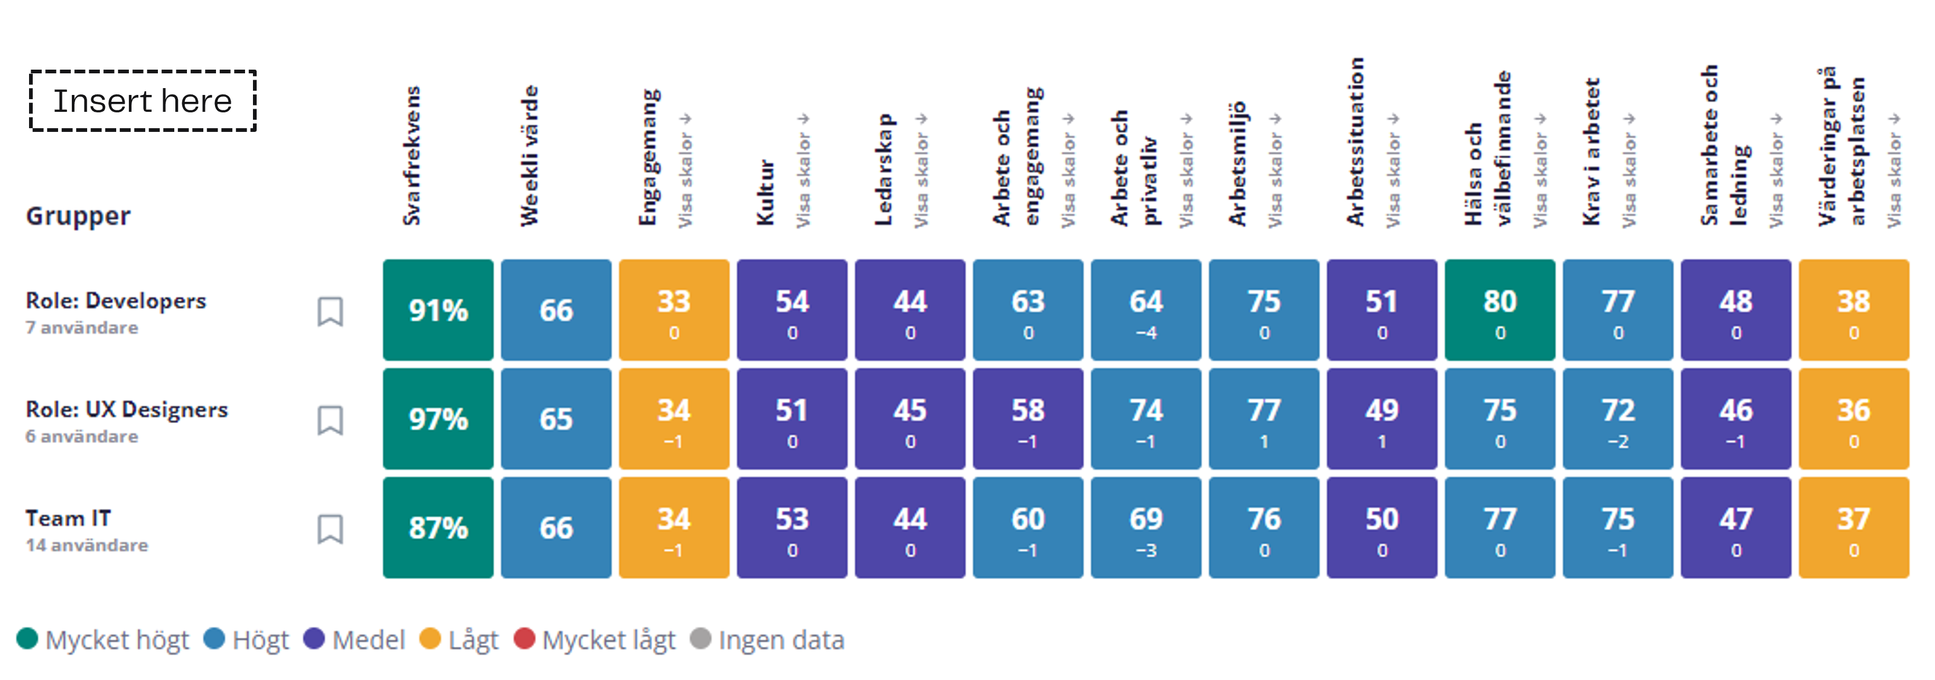
Heatmap

Slide 6
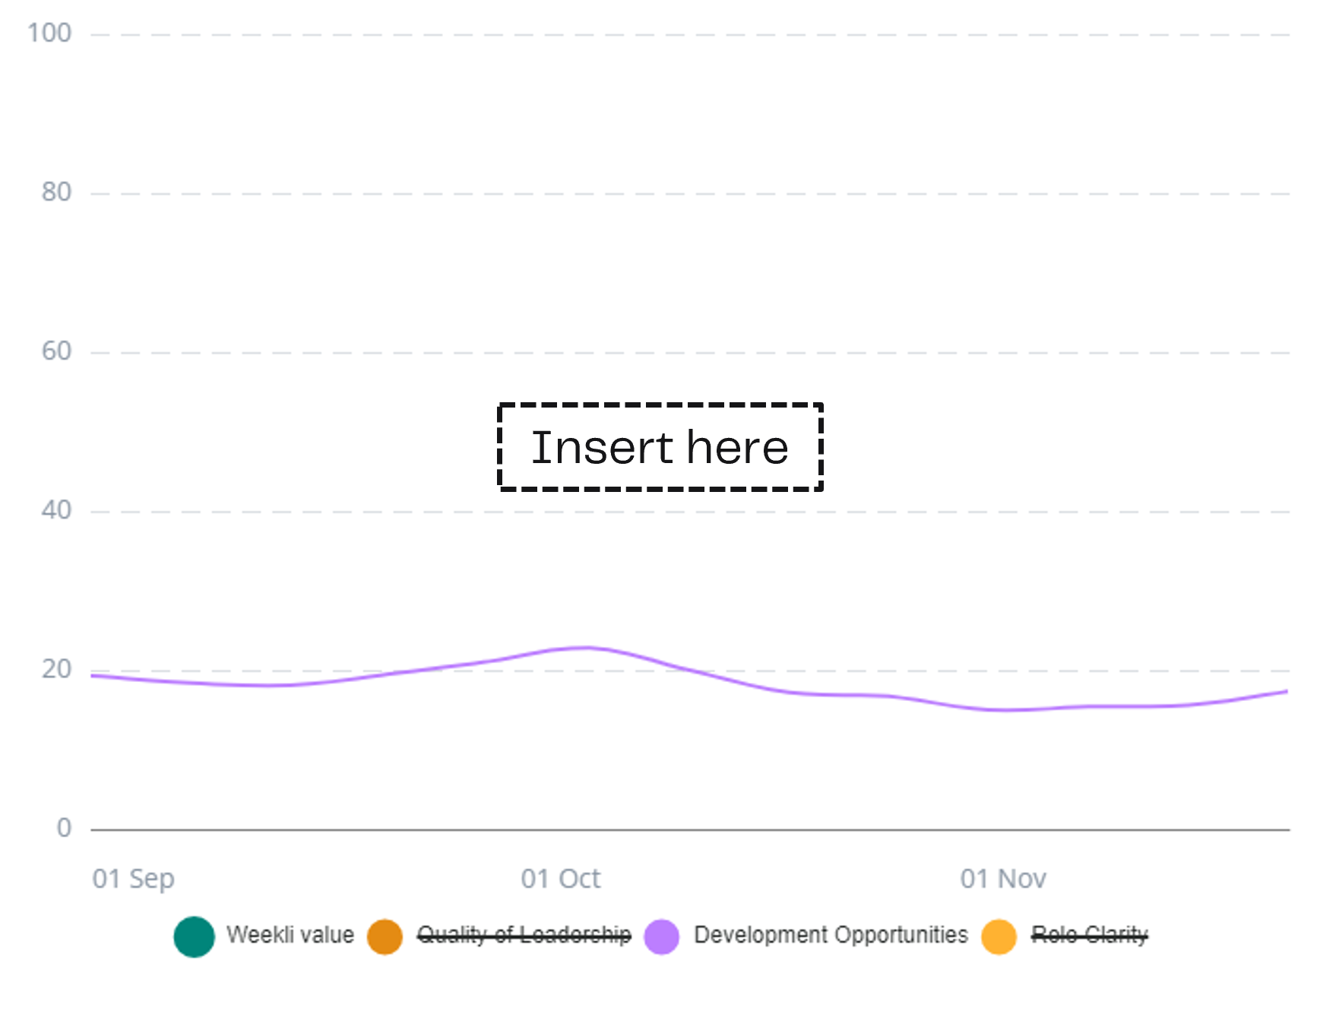
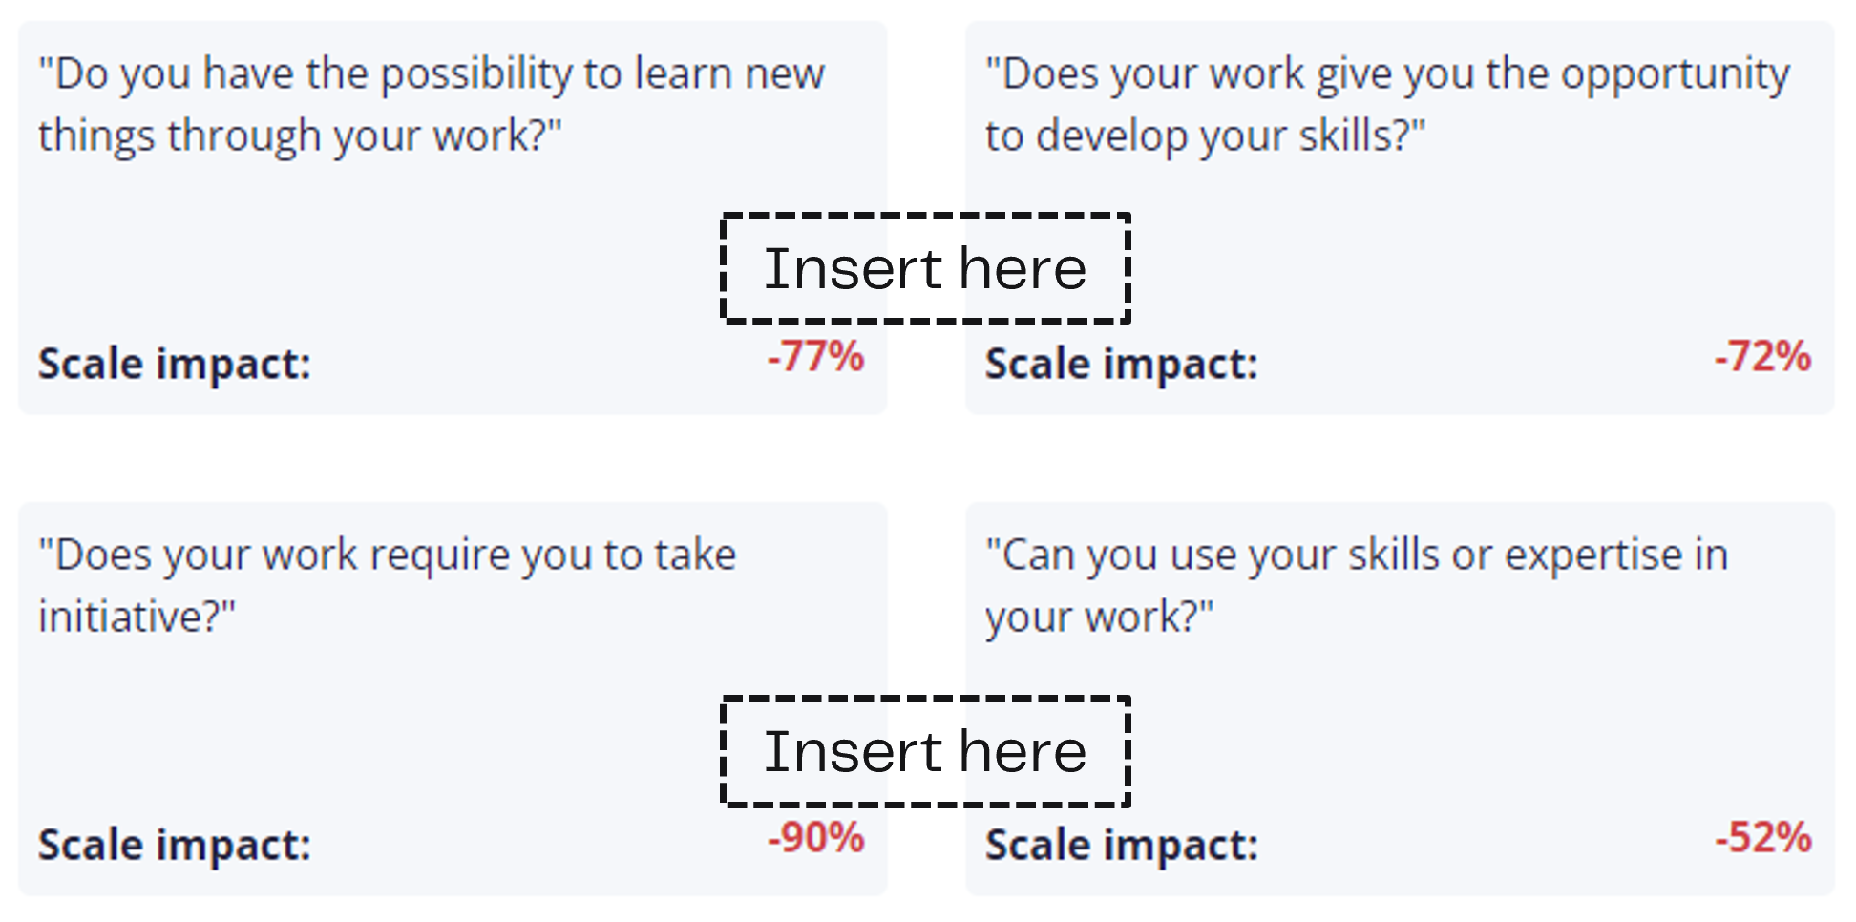
A deep dive – ”scale”
Share some aspect of data that could be relevant to have a discussion about

